Slide 1
CS 179: Lecture 14
Neural Networks and Backpropagation

Slide 2
Last Time
Intro to machine learning
Linear regression
Gradient descent
Linear classification = minimize cross-entropy

Slide 3
Today
Derivation of gradient descent for linear classifier
Using linear classifiers to build up neural networks
Gradient descent for neural networks (backpropagation)

Slide 4
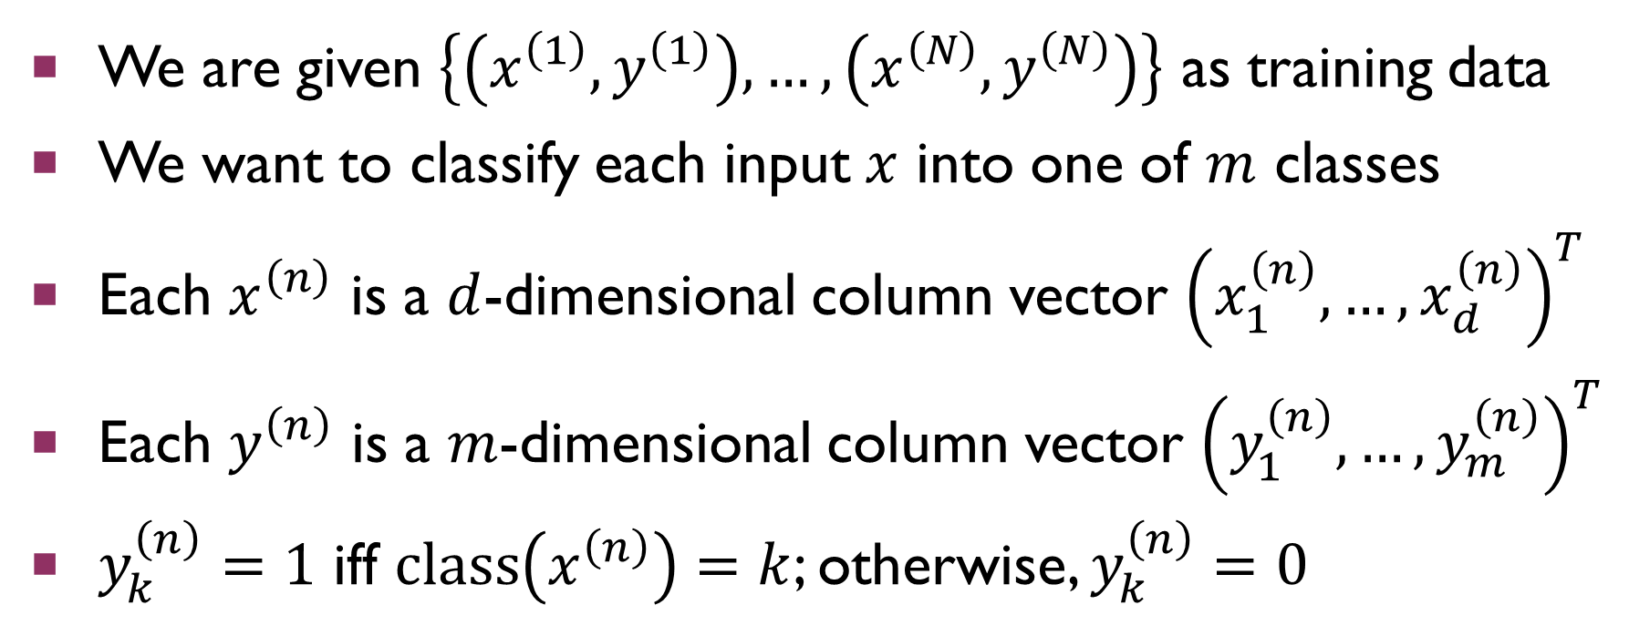
Refresher on The task
We are given $\left\{\left(x^{\left(1\right)},y^{\left(1\right)}\right),…,\left(x^{\left(N\right)},y^{\left(N\right)}\right)\right\}$ as training data
We want to classify each input $x$ into one of $m$ classes
Each $x^{\left(n\right)}$ is a $d$-dimensional column vector ${\left(x_{1}^{\left(n\right)},…,x_{d}^{\left(n\right)}\right)}^{T}$
Each $y^{\left(n\right)}$ is a $m$-dimensional column vector ${\left(y_{1}^{\left(n\right)},…,y_{m}^{\left(n\right)}\right)}^{T}$
$y_{k}^{\left(n\right)}=1$ iff $class\left(x^{\left(n\right)}\right)=k$; otherwise, $y_{k}^{\left(n\right)}=0$

Slide 5
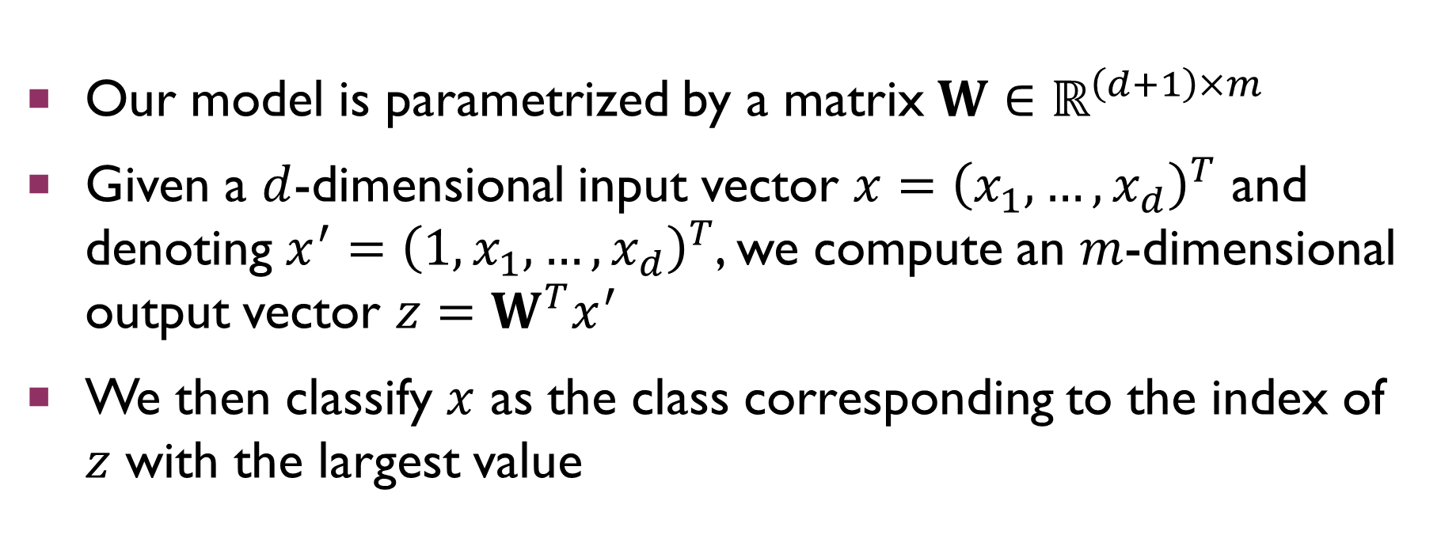
Refresher on The task
Our model is parametrized by a matrix $W∈ℝ^{\left(d+1\right)×m}$
Given a $d$-dimensional input vector $x={\left(x_{1},…,x_{d}\right)}^{T}$ and denoting $x^{′}={\left(1,x_{1},…,x_{d}\right)}^{T}$, we compute an $m$-dimensional output vector $z=W^{T}x^{′}$
We then classify $x$ as the class corresponding to the index of $z$ with the largest value

Slide 6
Linear Classifier Gradient
We will be going through some extra steps to derive the gradient of the linear classifier
The reason will become clear when we start talking about neural networks

Slide 7

Linear CLASSIFIER Gradient
Define intermediate variables
$$z=W^{T}x^{′}$$
$$p_{k}=\frac{\exp\left(z_{k}\right)}{\sum_{j=1}^{m}{\exp\left(z_{j}\right)}}; p={\left(p_{1},…,p_{m}\right)}^{T}$$
$$J=−\sum_{k=1}^{m}{y_{k}\ln\left(p_{k}\right)}$$

Slide 8
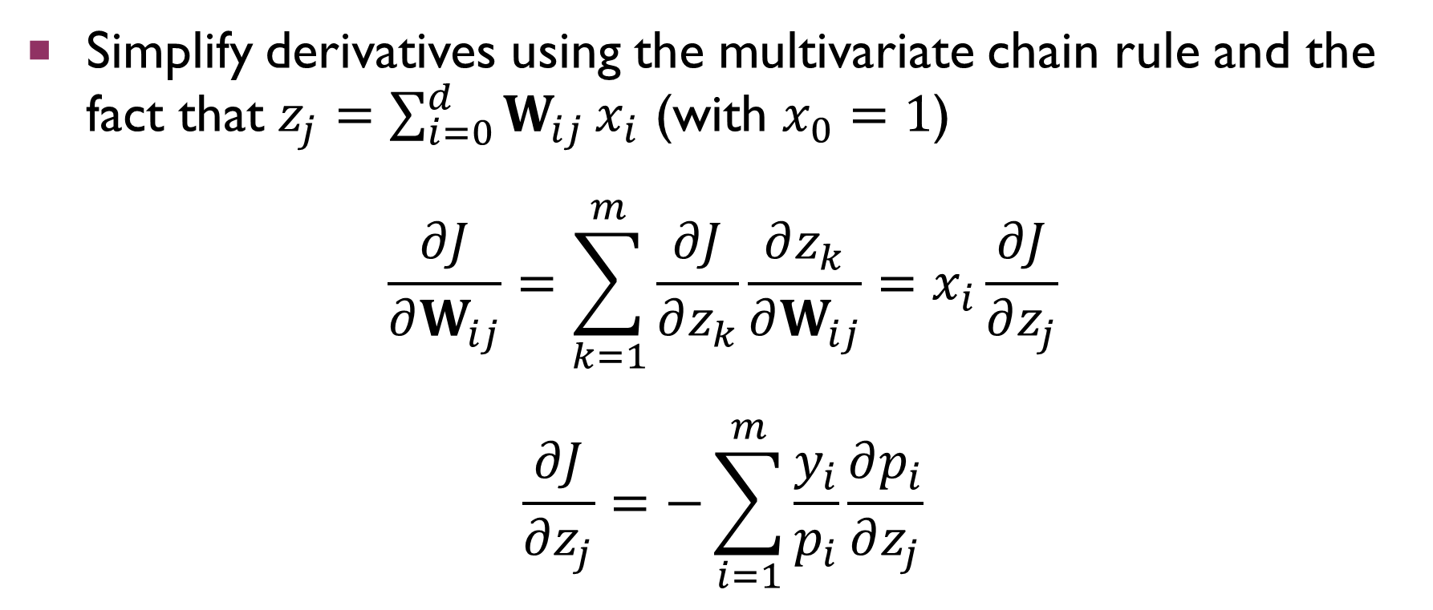
Linear CLASSIFIER Gradient
Simplify derivatives using the multivariate chain rule and the fact that $z_{j}=\sum_{i=0}^{d}{W_{ij}}x_{i}$ (with $x_{0}=1$)
$$\frac{∂J}{∂W_{ij}}=\sum_{k=1}^{m}{\frac{∂J}{∂z_{k}}\frac{∂z_{k}}{∂W_{ij}}}=x_{i}\frac{∂J}{∂z_{j}}$$
$$\frac{∂J}{∂z_{j}}=−\sum_{i=1}^{m}{\frac{y_{i}}{p_{i}}\frac{∂p_{i}}{∂z_{j}}}$$

Slide 9
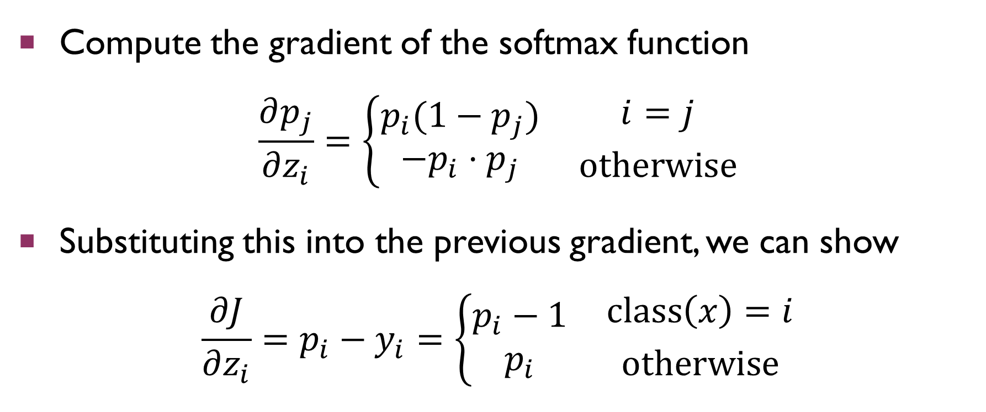
Linear CLASSIFIER Gradient
Compute the gradient of the softmax function
$$\frac{∂p_{j}}{∂z_{i}}=\left\{\begin{aligned}p_{i}(1−p_{j}) \\ −p_{i}⋅p_{j}\end{aligned}\right. {i=j \atop otherwise}$$
Substituting this into the previous gradient, we can show
$$\frac{∂J}{∂z_{i}}=p_{i}−y_{i}=\left\{\begin{aligned}p_{i}−1 \\ p_{i}\end{aligned}\right. {class\left(x\right)=i \atop otherwise}$$

Slide 10
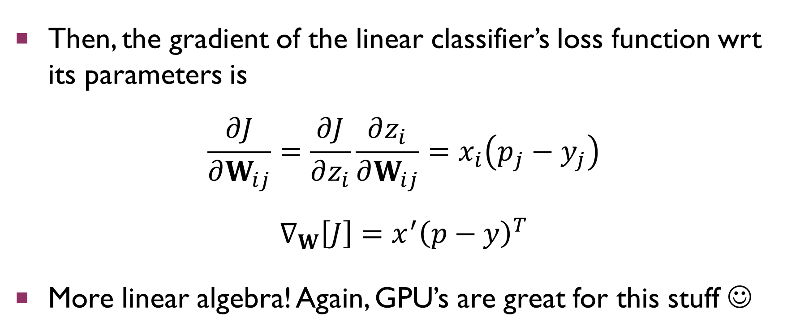
Linear CLASSIFIER Gradient
Then, the gradient of the linear classifier’s loss function wrt its parameters is
$$\frac{∂J}{∂W_{ij}}=\frac{∂J}{∂z_{i}}\frac{∂z_{i}}{∂W_{ij}}=x_{i}\left(p_{j}−y_{j}\right)$$
$$∇_{W}\left[J\right]=x^{′}{\left(p−y\right)}^{T}$$
More linear algebra! Again, GPU’s are great for this stuff ☺

Slide 11
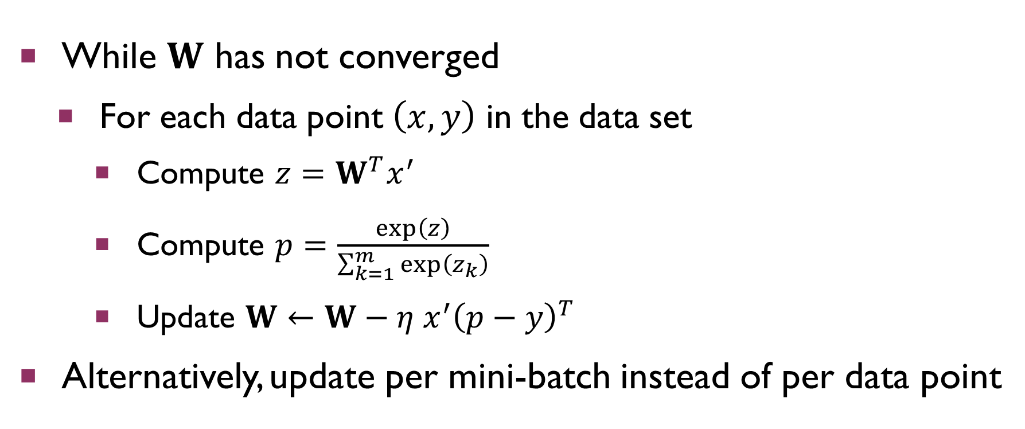
Stochastic Gradient Descent
While $W$ has not converged
For each data point $\left(x,y\right)$ in the data set
Compute $z=W^{T}x^{′}$
Compute $p=\frac{\exp\left(z\right)}{\sum_{k=1}^{m}{\exp\left(z_{k}\right)}}$
Update $W←W−η x^{′}{\left(p−y\right)}^{T}$
Alternatively, update per mini-batch instead of per data point

Slide 12
Limitations of Linear Models
Most real-world data is not separable by a linear decision boundary
Simplest example: XOR gate
What if we could combine the results of multiple linear classifiers?
Combine two OR gates with an AND gate to get a XOR gate
Notes:
Draw XOR gate and AND/OR combinations on board

Slide 13
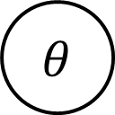

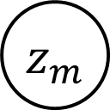
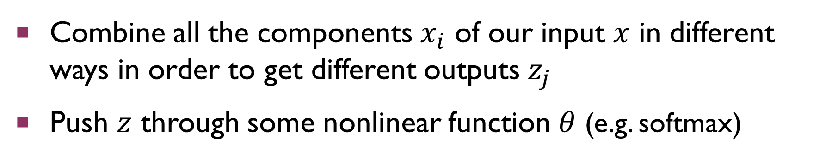
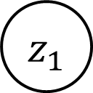

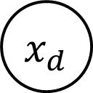

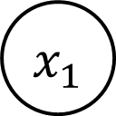

Another View of Linear Models
Combine all the components $x_{i}$ of our input $x$ in different ways in order to get different outputs $z_{j}$
Push $z$ through some nonlinear function $θ$ (e.g. softmax)
$x_{1}$
$z_{1}$
$θ$
$$f(x)$$
$x_{d}$
$z_{m}$
$θ$
$$W$$
$$W^{T}x^{′}$$

Slide 14
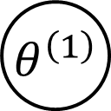
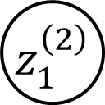


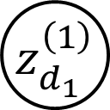
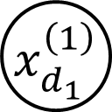
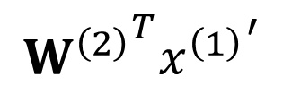
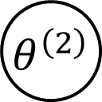
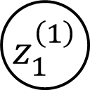
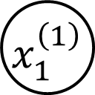
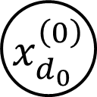

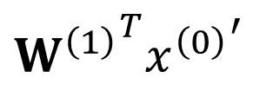
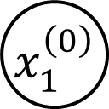

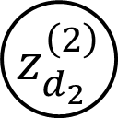
Neural Networks
What if we used each $θ(z_{j})$ as the input to another classifier?
This lets us compose multiple linear decision boundaries!
$x_{1}^{\left(0\right)}$
$z_{1}^{\left(1\right)}$
$θ^{\left(1\right)}$
$x_{1}^{\left(1\right)}$
$z_{1}^{\left(2\right)}$
$θ^{\left(2\right)}$
$$f\left(x^{\left(0\right)}\right)$$
$x_{d_{0}}^{\left(0\right)}$
$z_{d_{1}}^{\left(1\right)}$
$θ^{\left(1\right)}$
$x_{d_{1}}^{\left(1\right)}$
$z_{d_{2}}^{\left(2\right)}$
$θ^{\left(2\right)}$
$${W^{\left(1\right)}}^{T}{x^{\left(0\right)}}^{′}$$
$${W^{\left(2\right)}}^{T}{x^{\left(1\right)}}^{′}$$

Slide 15
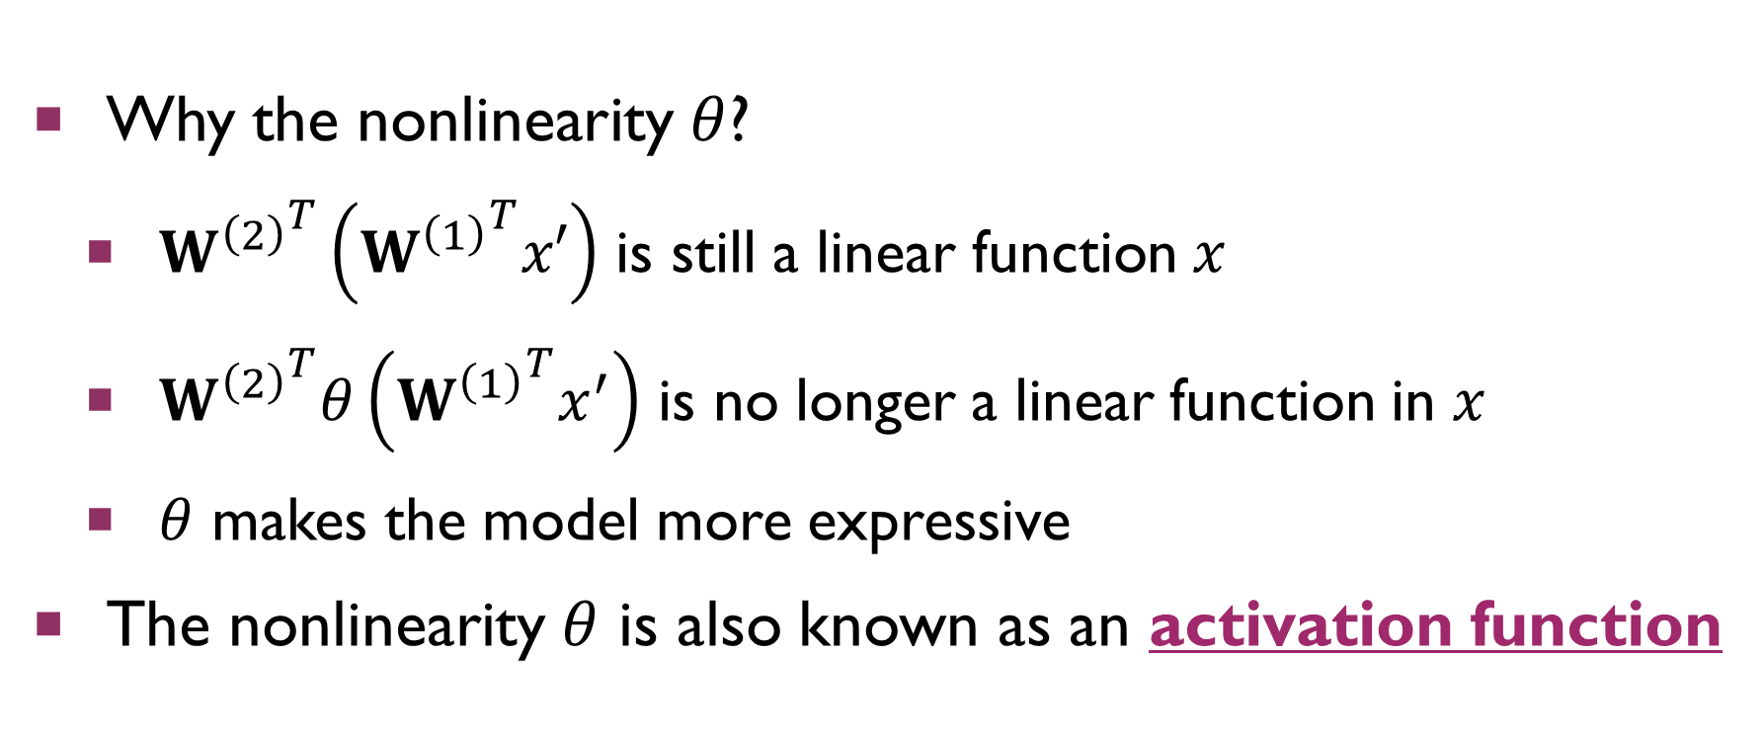
Neural Networks
Why the nonlinearity $θ$?
${W^{\left(2\right)}}^{T}\left({W^{\left(1\right)}}^{T}x′\right)$ is still a linear function $x$
${W^{\left(2\right)}}^{T}θ\left({W^{\left(1\right)}}^{T}x^{′}\right)$ is no longer a linear function in $x$
$θ$ makes the model more expressive
The nonlinearity $θ$ is also known as an activation function
Notes:
ReLU = rectified linear units, mention in slide

Slide 16
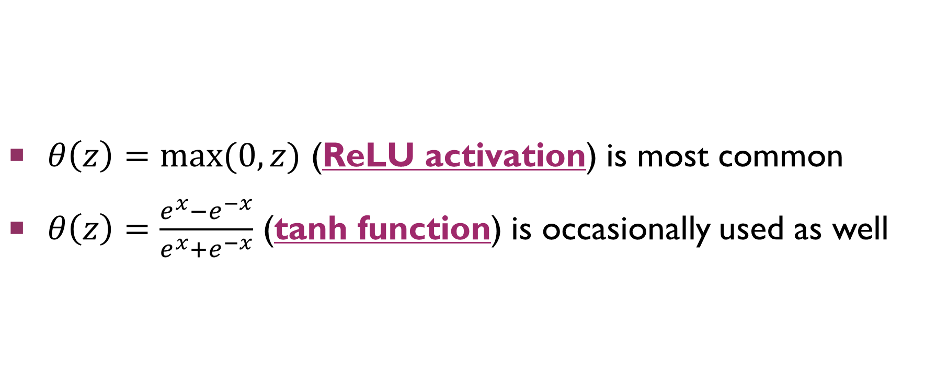
Examples of activations
$θ\left(z\right)=max⁡(0,z)$ (ReLU activation) is most common
$θ\left(z\right)=\frac{e^{x}−e^{−x}}{e^{x}+e^{−x}}$ (tanh function) is occasionally used as well
Notes:
ReLU = rectified linear units, mention in slide
Draw on board

Slide 17
Universal Approximator Thm
It is possible to show that if your neural network is big enough, it can approximate any continuous function arbitrarily well! (Hornik 1991)
This is why neural nets are important

Slide 18
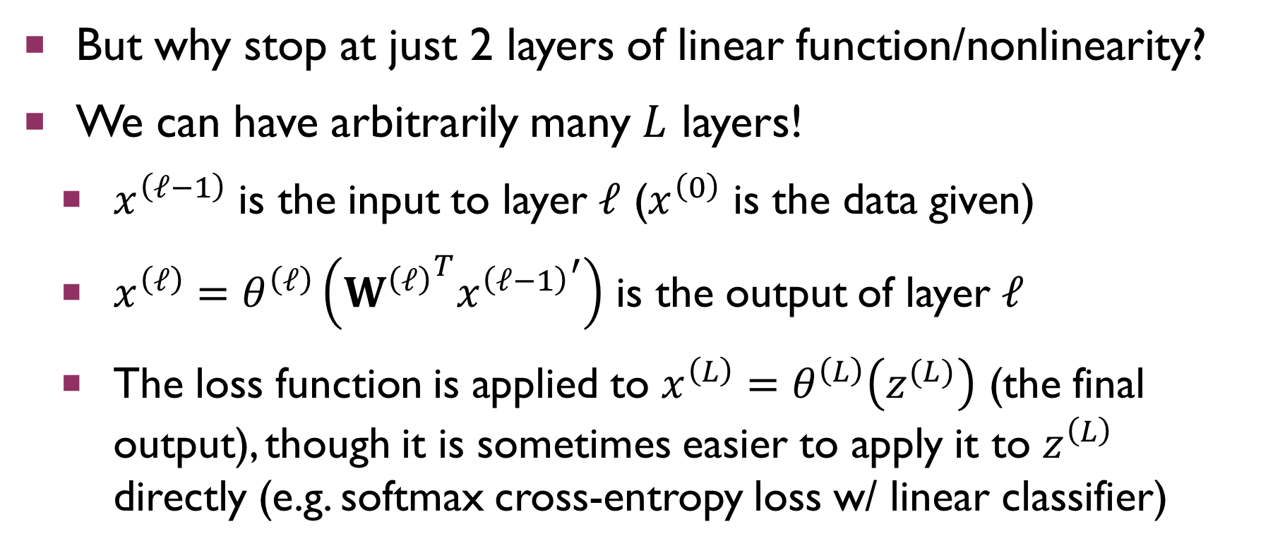
Neural Networks
But why stop at just 2 layers of linear function/nonlinearity?
We can have arbitrarily many $L$ layers!
$x^{\left(ℓ−1\right)}$ is the input to layer $ℓ$ ($x^{\left(0\right)}$ is the data given)
$x^{\left(ℓ\right)}=θ^{\left(ℓ\right)}\left({W^{\left(ℓ\right)}}^{T}{x^{\left(ℓ−1\right)}}^{′}\right)$ is the output of layer $ℓ$
The loss function is applied to $x^{\left(L\right)}=θ^{\left(L\right)}\left(z^{(L)}\right)$ (the final output), though it is sometimes easier to apply it to $z^{\left(L\right)}$ directly (e.g. softmax cross-entropy loss w/ linear classifier)

Slide 19
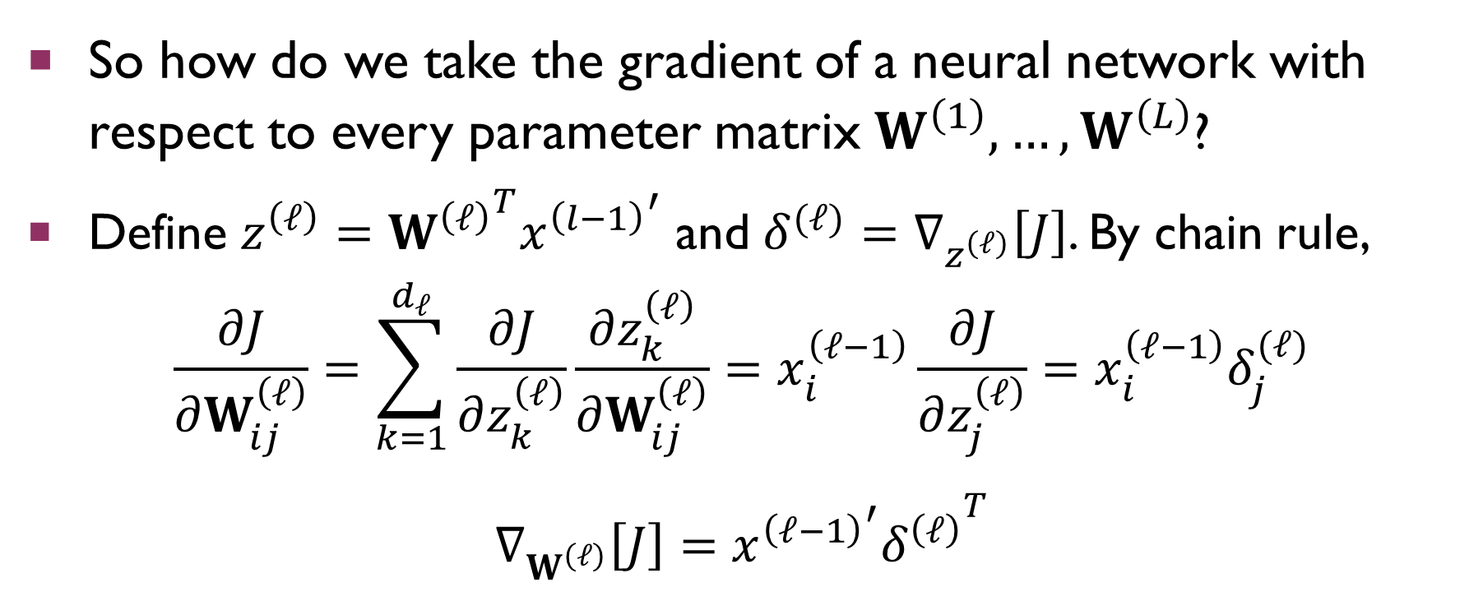
Backpropagation
So how do we take the gradient of a neural network with respect to every parameter matrix $W^{\left(1\right)},…,W^{\left(L\right)}$?
Define $z^{\left(ℓ\right)}={W^{\left(ℓ\right)}}^{T}{x^{\left(l−1\right)}}^{′}$ and $δ^{(ℓ)}=∇_{z^{\left(ℓ\right)}}\left[J\right]$. By chain rule,
$$\frac{∂J}{∂W_{ij}^{\left(ℓ\right)}}=\sum_{k=1}^{d_{ℓ}}{\frac{∂J}{∂z_{k}^{\left(ℓ\right)}}\frac{∂z_{k}^{\left(ℓ\right)}}{∂W_{ij}^{\left(ℓ\right)}}}=x_{i}^{\left(ℓ−1\right)}\frac{∂J}{∂z_{j}^{\left(ℓ\right)}}=x_{i}^{\left(ℓ−1\right)}δ_{j}^{(ℓ)}$$
$$∇_{W^{\left(ℓ\right)}}\left[J\right]={{x^{\left(ℓ−1\right)}}^{′}δ^{\left(ℓ\right)}}^{T}$$

Slide 20
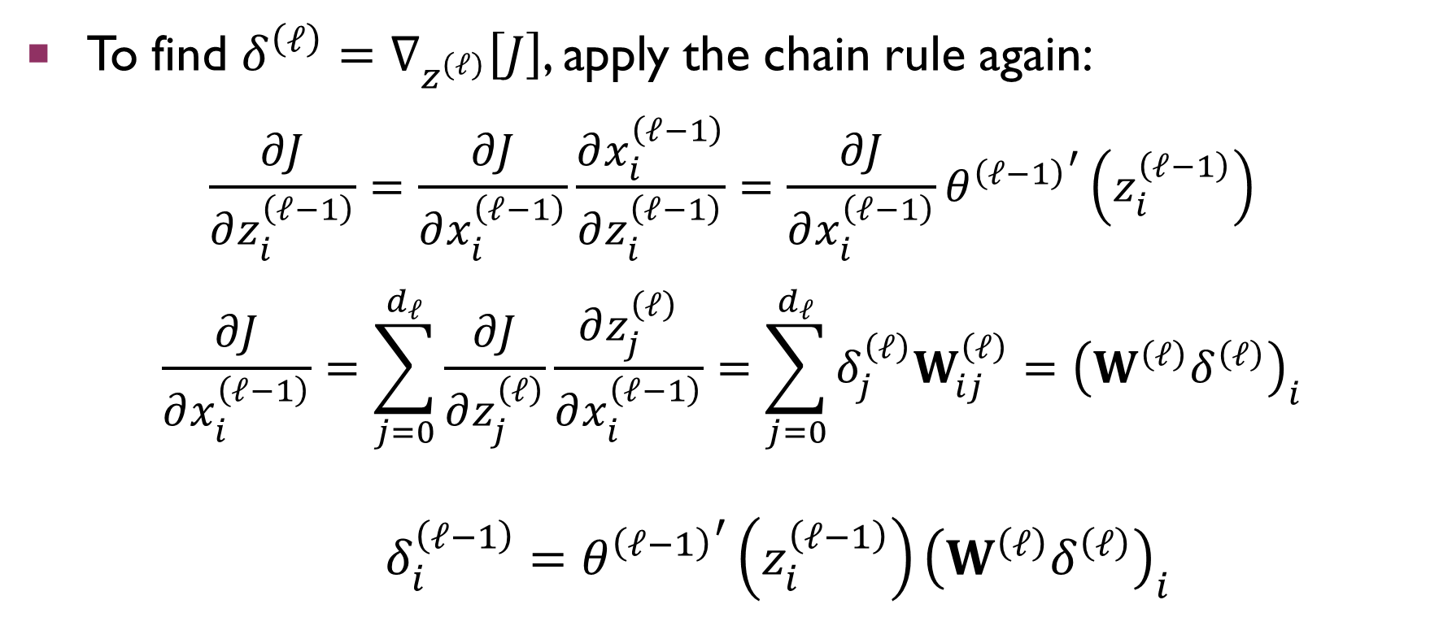
Backpropagation
To find $δ^{\left(ℓ\right)}=∇_{z^{\left(ℓ\right)}}\left[J\right]$, apply the chain rule again:
$$\frac{∂J}{∂z_{i}^{\left(ℓ−1\right)}}=\frac{∂J}{∂x_{i}^{\left(ℓ−1\right)}}\frac{∂x_{i}^{\left(ℓ−1\right)}}{∂z_{i}^{\left(ℓ−1\right)}}=\frac{∂J}{∂x_{i}^{\left(ℓ−1\right)}}{θ^{\left(ℓ−1\right)}}^{′}\left(z_{i}^{\left(ℓ−1\right)}\right)$$
$$\frac{∂J}{∂x_{i}^{\left(ℓ−1\right)}}=\sum_{j=0}^{d_{ℓ}}{\frac{∂J}{∂z_{j}^{\left(ℓ\right)}}\frac{∂z_{j}^{\left(ℓ\right)}}{∂x_{i}^{\left(ℓ−1\right)}}}=\sum_{j=0}^{d_{ℓ}}{δ_{j}^{\left(ℓ\right)}W_{ij}^{\left(ℓ\right)}}={\left(W^{\left(ℓ\right)}δ^{\left(ℓ\right)}\right)}_{i}$$
$$δ_{i}^{\left(ℓ−1\right)}={θ^{\left(ℓ−1\right)}}^{′}\left(z_{i}^{\left(ℓ−1\right)}\right){\left(W^{\left(ℓ\right)}δ^{\left(ℓ\right)}\right)}_{i}$$

Slide 21
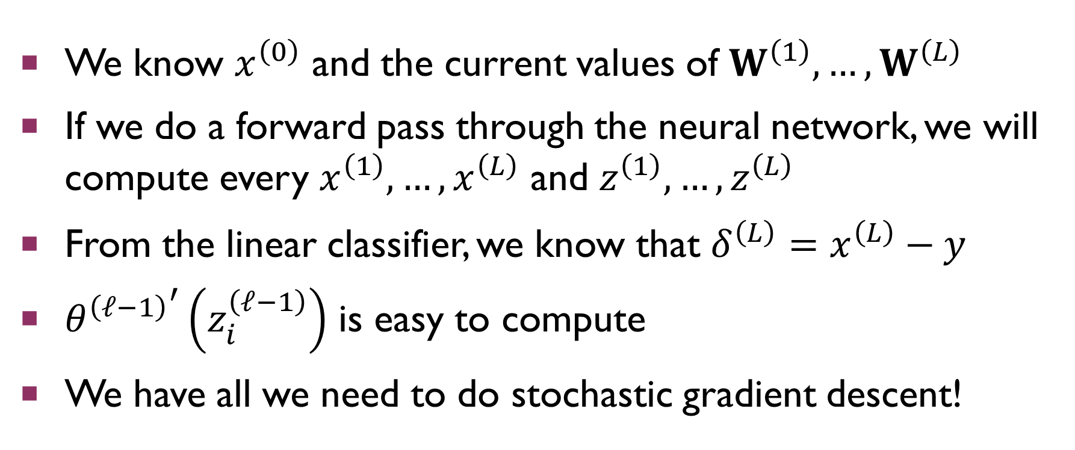
Backpropagation
We know $x^{\left(0\right)}$ and the current values of $W^{\left(1\right)},…,W^{\left(L\right)}$
If we do a forward pass through the neural network, we will compute every $x^{\left(1\right)},…,x^{\left(L\right)}$ and $z^{\left(1\right)},…,z^{\left(L\right)}$
From the linear classifier, we know that $δ^{\left(L\right)}=x^{\left(L\right)}−y$
${θ^{\left(ℓ−1\right)}}^{′}\left(z_{i}^{\left(ℓ−1\right)}\right)$ is easy to compute
We have all we need to do stochastic gradient descent!

Slide 22
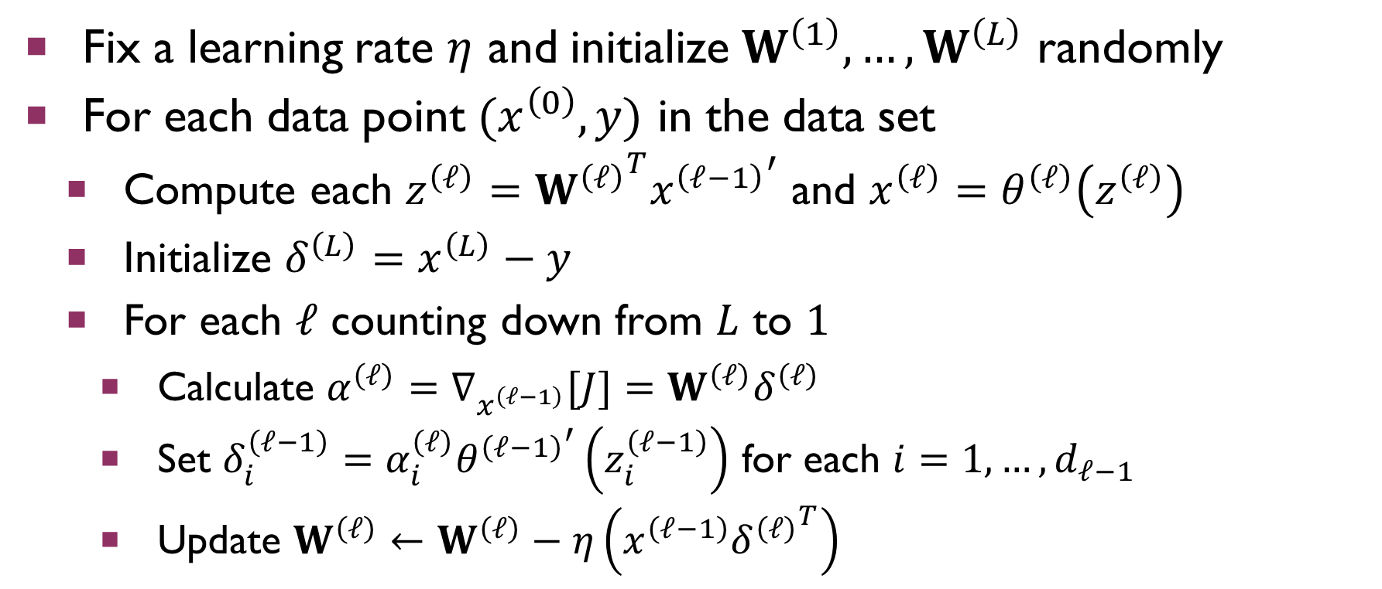
Backpropagation
Fix a learning rate $η$ and initialize $W^{\left(1\right)},…,W^{\left(L\right)}$ randomly
For each data point $(x^{\left(0\right)},y)$ in the data set
Compute each $z^{\left(ℓ\right)}={W^{\left(ℓ\right)}}^{T}{x^{\left(ℓ−1\right)}}^{′}$ and $x^{\left(ℓ\right)}=θ^{\left(ℓ\right)}\left(z^{\left(ℓ\right)}\right)$
Initialize $δ^{\left(L\right)}=x^{\left(L\right)}−y$
For each $ℓ$ counting down from $L$ to $1$
Calculate $α^{\left(ℓ\right)}=∇_{x^{\left(ℓ−1\right)}}[J]=W^{\left(ℓ\right)}δ^{\left(ℓ\right)}$
Set $δ_{i}^{\left(ℓ−1\right)}=α_{i}^{\left(ℓ\right)}{θ^{\left(ℓ−1\right)}}^{′}\left(z_{i}^{\left(ℓ−1\right)}\right)$ for each $i=1,…,d_{ℓ−1}$
Update $W^{\left(ℓ\right)}←W^{\left(ℓ\right)}−η\left(x^{\left(ℓ−1\right)}{δ^{\left(ℓ\right)}}^{T}\right)$

Slide 23
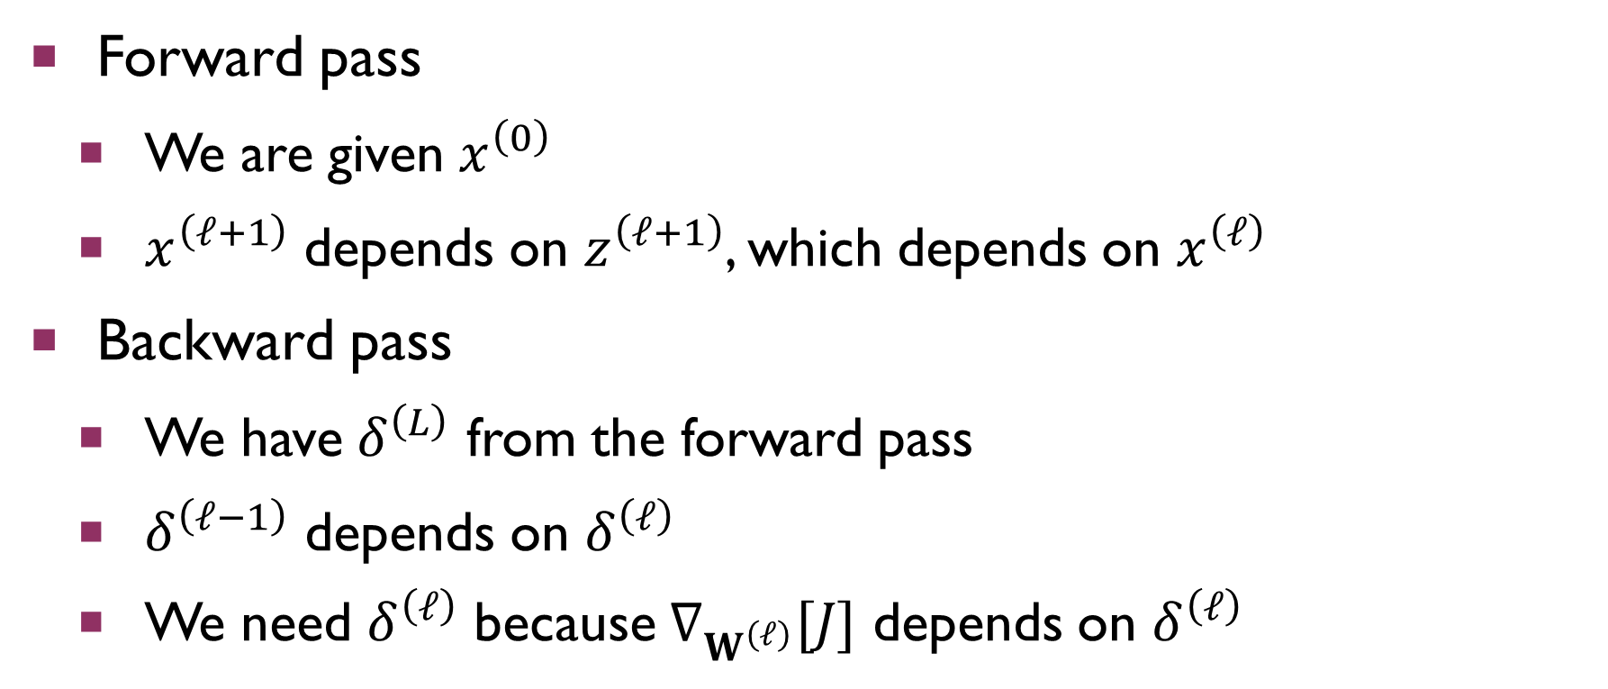
Backpropagation
Forward pass
We are given $x^{\left(0\right)}$
$x^{\left(ℓ+1\right)}$ depends on $z^{\left(ℓ+1\right)}$, which depends on $x^{\left(ℓ\right)}$
Backward pass
We have $δ^{\left(L\right)}$ from the forward pass
$δ^{\left(ℓ−1\right)}$ depends on $δ^{\left(ℓ\right)}$
We need $δ^{\left(ℓ\right)}$ because $∇_{W^{\left(ℓ\right)}}[J]$ depends on $δ^{\left(ℓ\right)}$

Slide 24
Backpropagation
This is stochastic gradient descent for a neural network!
In Homework #5, you will:
Implement a linear classifier
Extend it to a 2-layer neural network
Before discussing implementation details, let’s talk about parallelizing the backpropagation algorithm

Slide 25
Parallelization
By its nature, the backpropagation algorithm seems fundamentally sequential
However, each sequential step is a linear algebra operation
Parallelize with cuBLAS
Minibatch stochastic gradient descent
Compute the gradient for each data point in the minibatch
Use a parallel reduction to take the average at the end

Slide 26
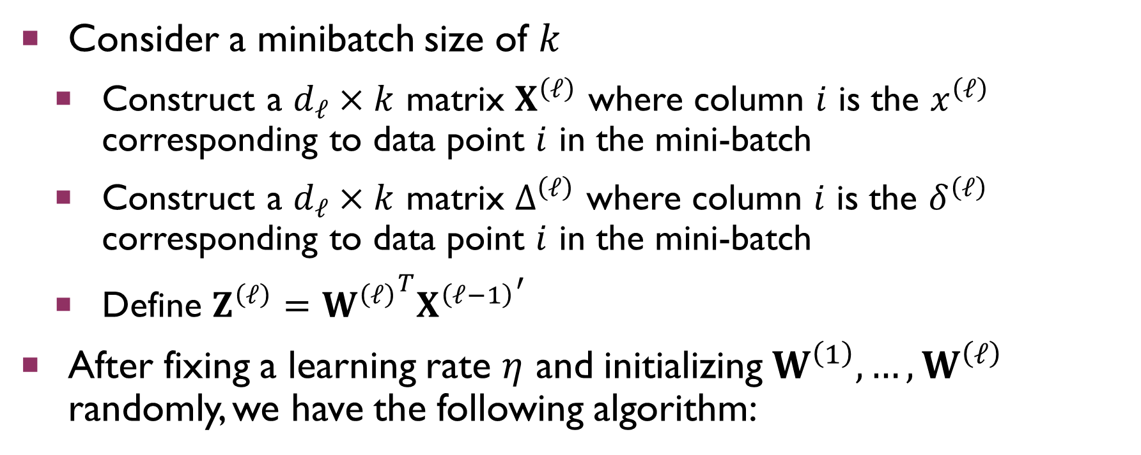
Using Minibatches
Consider a minibatch size of $k$
Construct a $d_{ℓ}×k$ matrix $X^{\left(ℓ\right)}$ where column $i$ is the $x^{\left(ℓ\right)}$ corresponding to data point $i$ in the mini-batch
Construct a $d_{ℓ}×k$ matrix $Δ^{\left(ℓ\right)}$ where column $i$ is the $δ^{\left(ℓ\right)}$ corresponding to data point $i$ in the mini-batch
Define $Z^{\left(ℓ\right)}={W^{\left(ℓ\right)}}^{T}{X^{\left(ℓ−1\right)}}^{′}$
After fixing a learning rate $η$ and initializing $W^{\left(1\right)},…,W^{\left(ℓ\right)}$ randomly, we have the following algorithm:

Slide 27
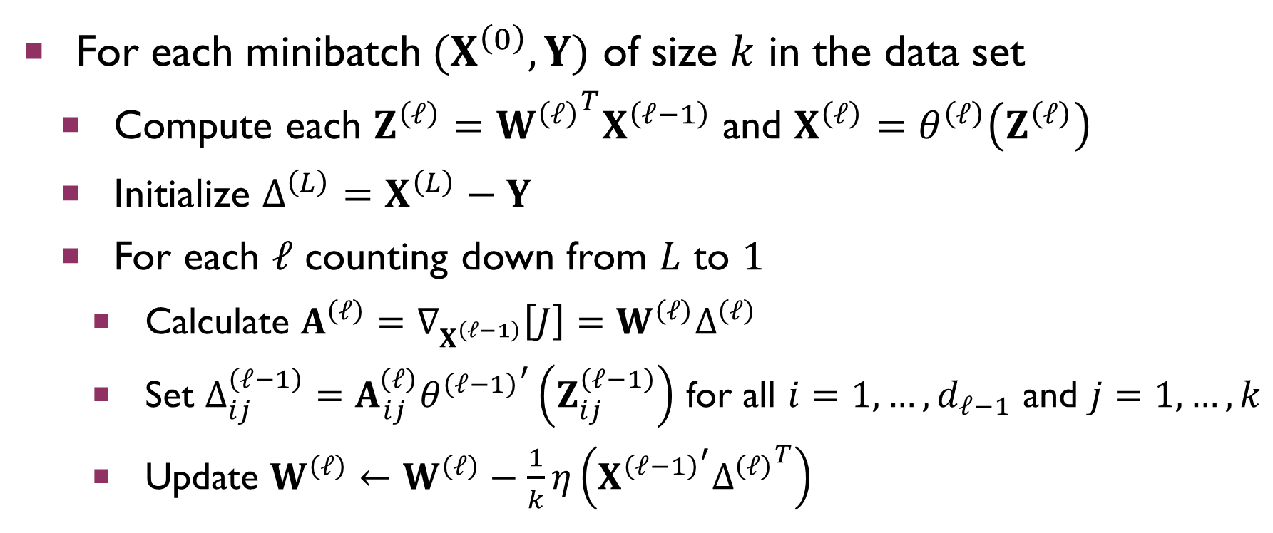
Using Minibatches
For each minibatch $(X^{\left(0\right)},Y)$ of size $k$ in the data set
Compute each $Z^{\left(ℓ\right)}={W^{\left(ℓ\right)}}^{T}X^{\left(ℓ−1\right)}$ and $X^{\left(ℓ\right)}=θ^{\left(ℓ\right)}\left(Z^{\left(ℓ\right)}\right)$
Initialize $Δ^{\left(L\right)}=X^{\left(L\right)}−Y$
For each $ℓ$ counting down from $L$ to $1$
Calculate $A^{\left(ℓ\right)}=∇_{X^{\left(ℓ−1\right)}}\left[J\right]=W^{\left(ℓ\right)}Δ^{\left(ℓ\right)}$
Set $Δ_{ij}^{\left(ℓ−1\right)}=A_{ij}^{\left(ℓ\right)}{θ^{\left(ℓ−1\right)}}^{′}\left(Z_{ij}^{\left(ℓ−1\right)}\right)$ for all $i=1,…,d_{ℓ−1}$ and $j=1,…,k$
Update $W^{\left(ℓ\right)}←W^{\left(ℓ\right)}−\frac{1}{k}η\left({X^{\left(ℓ−1\right)}}^{′}{Δ^{\left(ℓ\right)}}^{T}\right)$

Slide 28
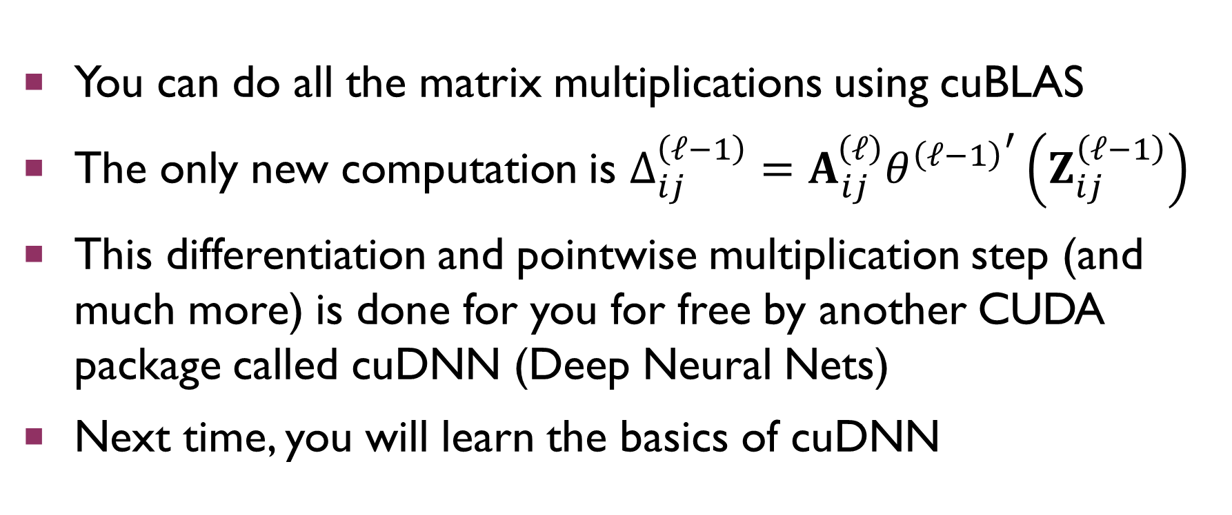
Implementation
You can do all the matrix multiplications using cuBLAS
The only new computation is $Δ_{ij}^{\left(ℓ−1\right)}=A_{ij}^{\left(ℓ\right)}{θ^{\left(ℓ−1\right)}}^{′}\left(Z_{ij}^{\left(ℓ−1\right)}\right)$
This differentiation and pointwise multiplication step (and much more) is done for you for free by another CUDA package called cuDNN (Deep Neural Nets)
Next time, you will learn the basics of cuDNN

